Slide 1

Project on ROUTINE GENERATION SYSTEM
Presented by:
ARITRA BANERJEE
KRISHANU MAHATRAN

Slide 2

ABOUT THE PROJECT
In-House Project that needs no web connection.
For the sole usage of members within an institute.
Key Entities- Administrator and Faculties.
This software is meant to generate routines easily and fast, based on certain constraints. No confusion faced as in manual routine systems.

Slide 3

Hardware Secification
AMD A8-7410 APU processor
8GB of system memory (RAM)
1TB of hard-drive space

Slide 4

Software Specification
Developer Tool: Visual Studios 2012
Language Domain: C#.net
Database (Back-end): SQL SERVER using ADO.NET driver.
Documentation Tool: Microsoft Word 2007

Slide 5

Advantages of this application
No more paper work.
Easy record generation.
Error free.
Access to every employee detail.
Increased security and confidentiality.

Slide 6
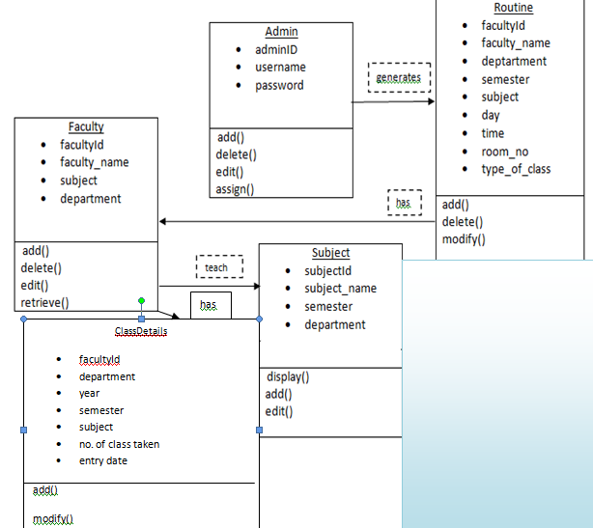
CLASS DIAGRAM

Slide 7
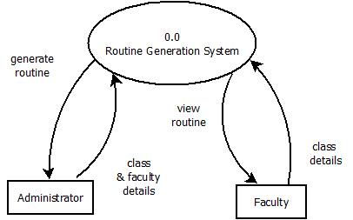
Context/Zero level DFD

Slide 8
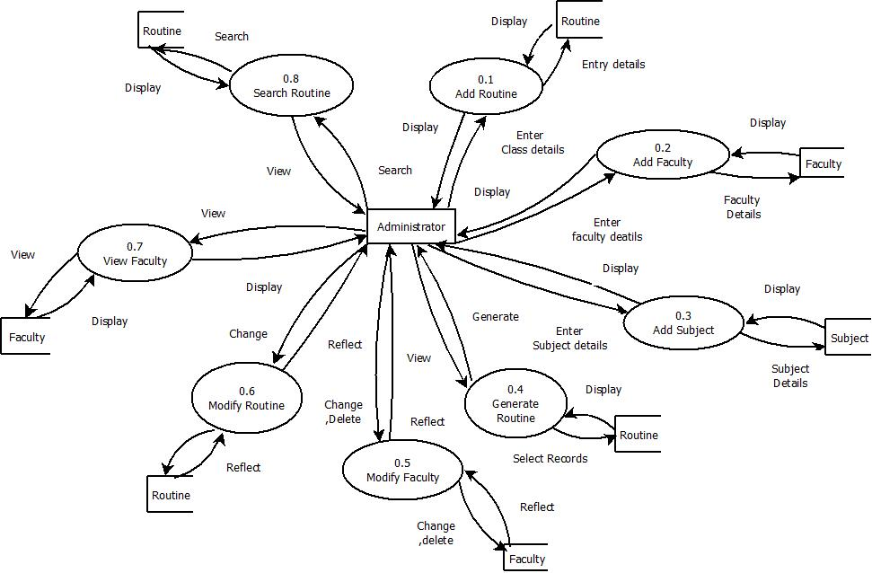
Level 1 Administrator

Slide 9
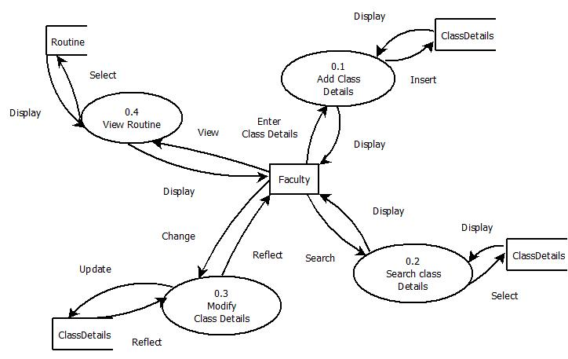
Level 1 faculty

Slide 10
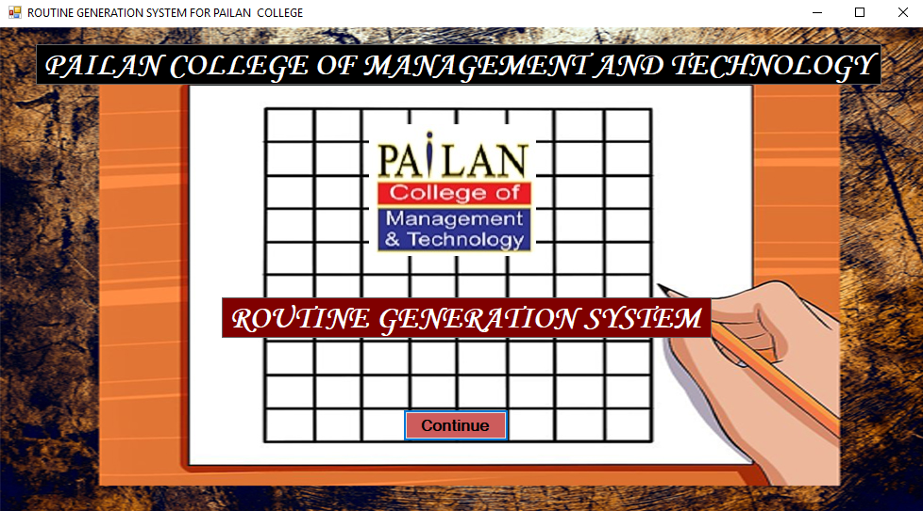

Slide 11
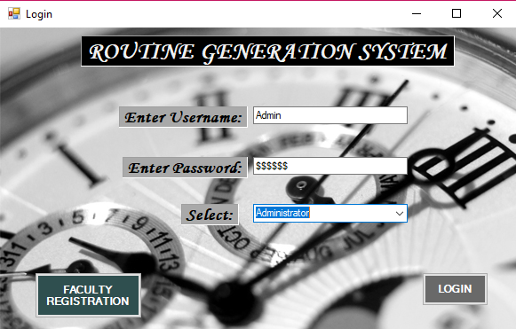

Slide 12
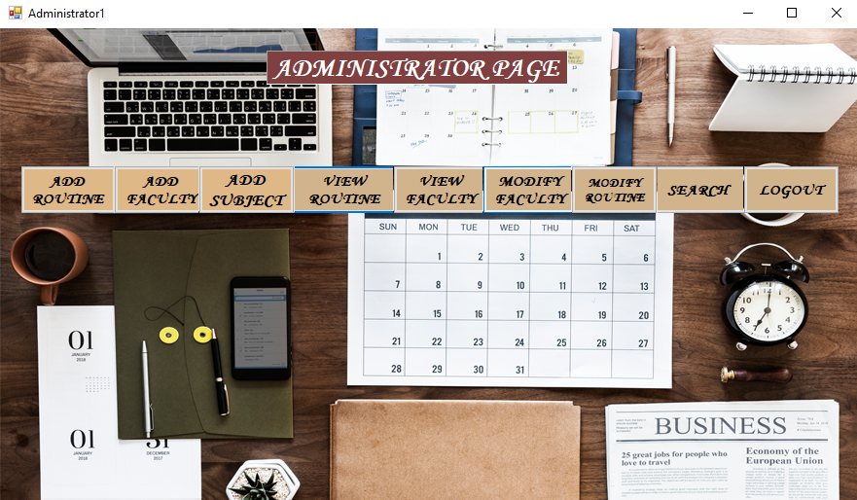

Slide 13
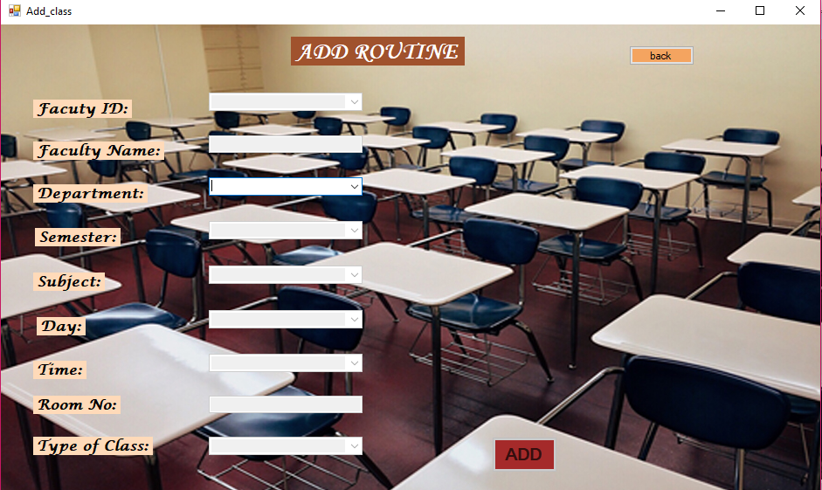

Slide 14
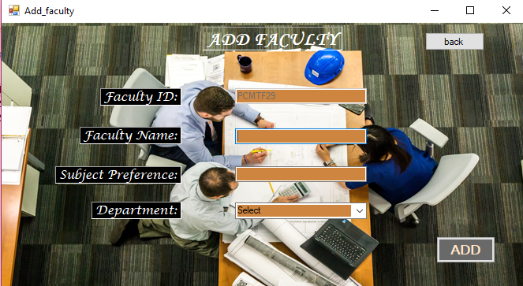

Slide 15
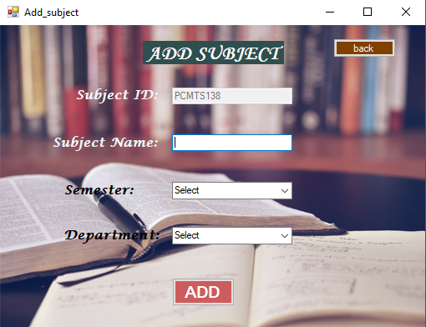

Slide 16
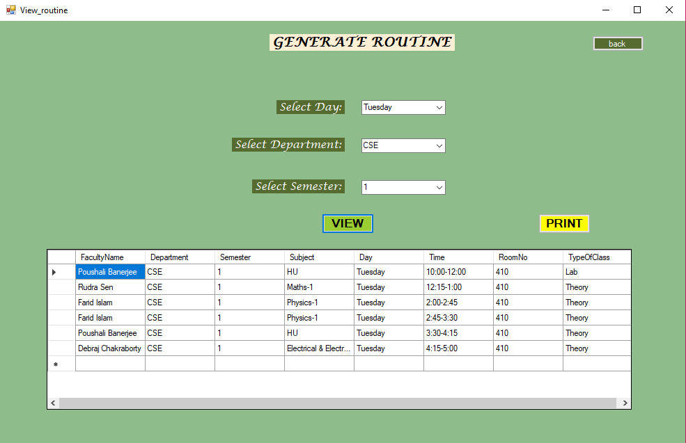

Slide 17
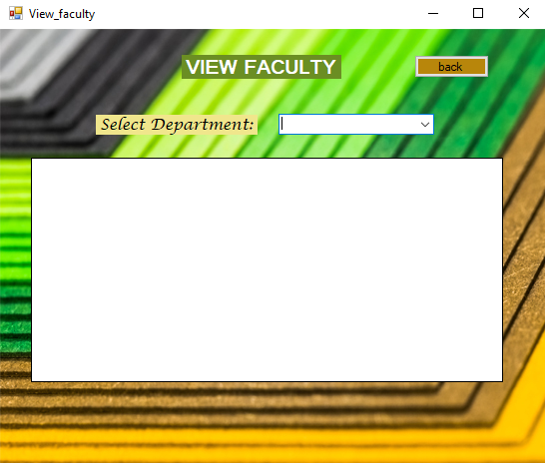

Slide 18
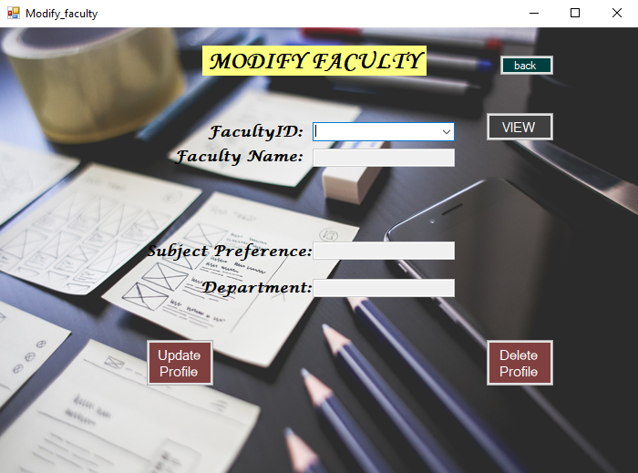

Slide 19
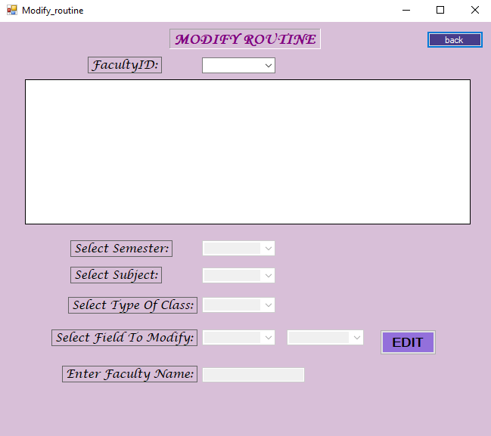

Slide 20
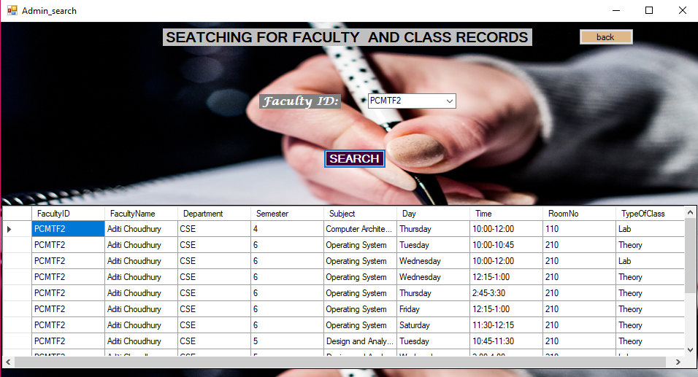

Slide 21
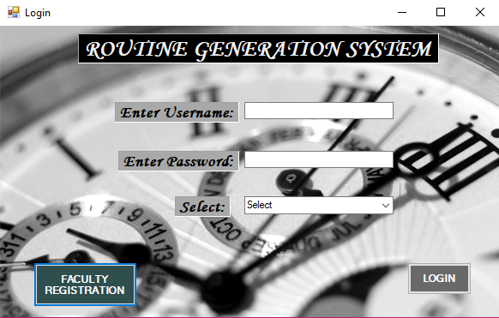

Slide 22
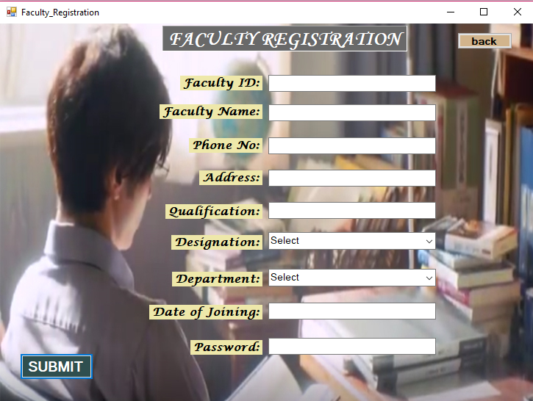

Slide 23
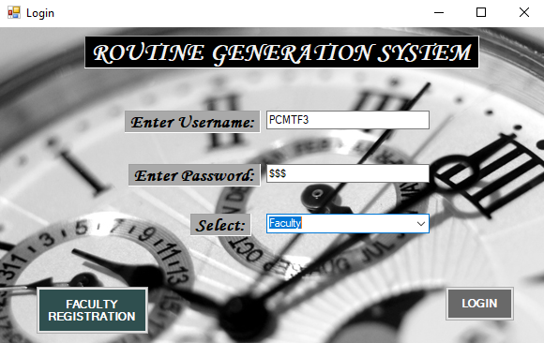

Slide 24
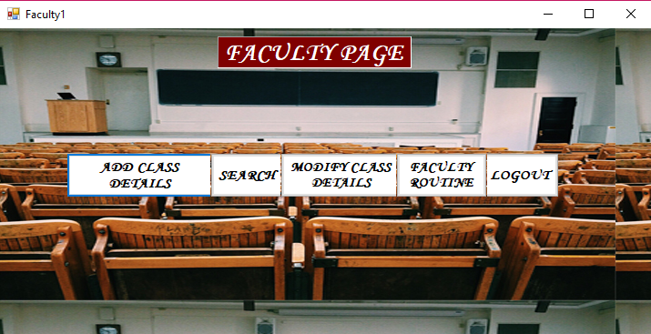

Slide 25
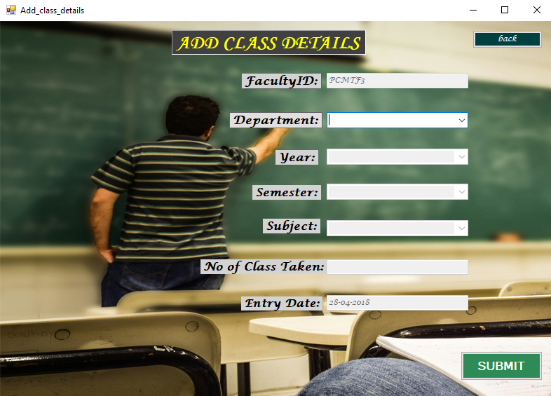

Slide 26
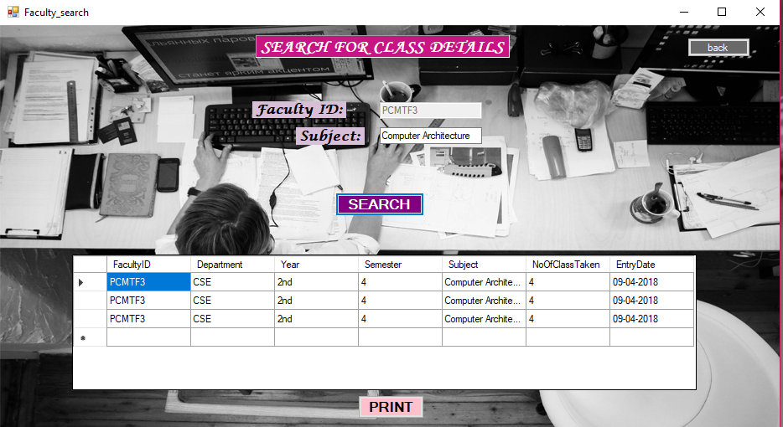

Slide 27
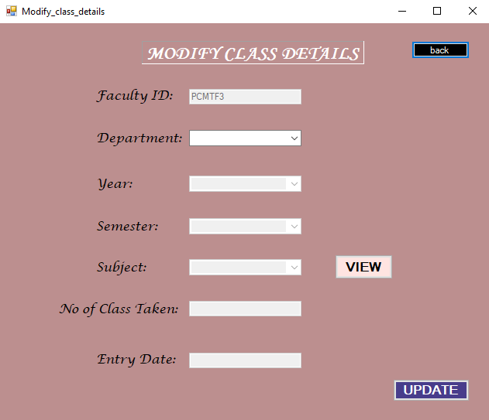

Slide 28
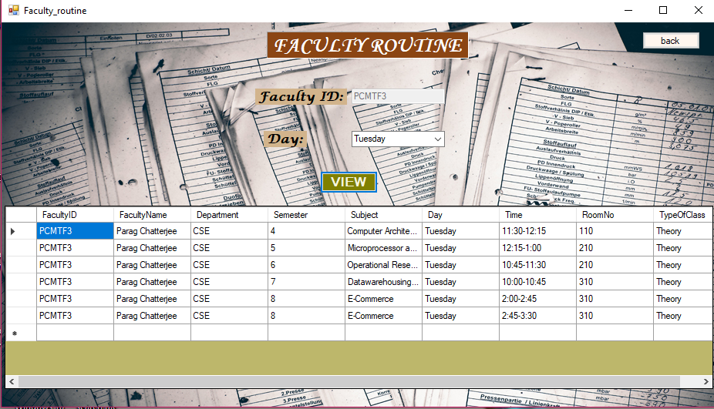

Slide 29
CONCLUSION
By analysing today’s scenario, the usage of this software is more advantageous than preparing time tables manually.
It helps to reduce risk as well as headache of academic authorities ,specially the teachers who are responsible for creating time tables.
Thus it is better to take the aid of this software for better management of institute routines.
Notes:
In concluding this ppt I would say, in modern scenario routine generation system ll be more beneficial than manually prepared time tables. A lot of confusion will be reduced for the teachers. Thus it is better to take the help of our project for better management of institute routines.

Slide 30

THANK YOU!!!
Notes:
That is all . Thank you!

